Slide 1
ETN data to OBIS event format
OBIS Event Data Workshop
23-26 April 2018

Slide 2
ETN telemetry data
Bird tracking data (Sea Gulls)
Fish tags (eels and cod)
CPODs (dolphins – passive listening)
OBIS-env data project 2015/2017
Notes:
So at VLIZ we hold 3 types of tracking and tagging datasets and I’ll give a proposal for all three on how to exchange these data with biodiversity databases like OBIS using DwC.
OBIS-env data project 2015/2017 (Main focus on sampling data but also some ideas regarding tracking data)

Slide 3
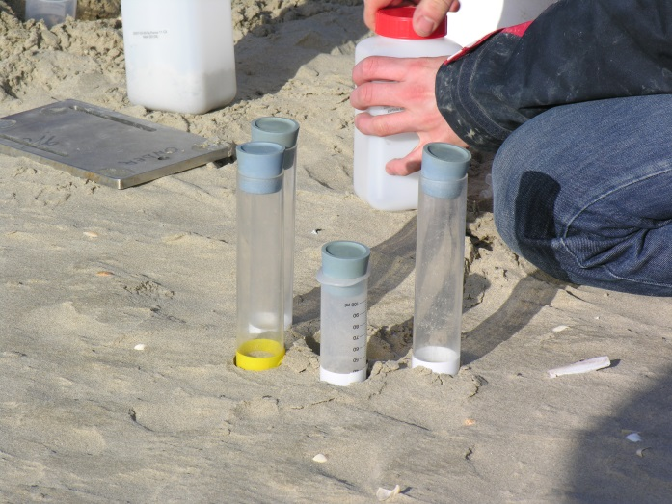
Biological samples: more than just species occurrences…
Meiofauna and associated sediment sampling
Core sample from a Van Veen grab
Water sample from Niskin bottle
Video plankton recorder
OTN tags
plankton net with CTD
Notes:
When OBIS was founded, the focus was to document where and when a taxon was found.
However many datasets contain more information than just where and when a specimen was found. For example meiofauna which was sampled together with sediment. You can have subsamples, abundances. You can have watersamples with nutrients. You can have automated data such as obtained by tracking tags or by a Viodeo Plankton Recorder.
So OBIS event data project was about how to exchange these data to OBIS. We wanted to develop a Darwin Core standard that was able to include all these different types of data.

Slide 4
Types of data
Biotic measurements
Abundance
Biomass
Length measurements
Specimens characteristics (shell thickness, wing size, biovolume, ... )
Abiotic measurements
Sediment properties
Water properties
...
Sampling descriptors
Which sampling instrument used?
Dimensions of the instrument
Mesh size
How is the instrument used
Sampling duration
(Average) vessel speed
Vertical vs horizontal towing
Sediment penetration depth
Processing parameters
Sieve mesh size
Filter pore size
Subsamples
OCCURRENCE
(Sample) EVENT
(Sample) EVENT
Notes:
So in addition to where an when a taxon occurred, we wanted to be able to store the following 3 types of data as well. Biotic measurements, Abiotic measurements and Sampling information.

Slide 5
OBIS DATA format for Event Data
Darwin Core
Extended
MeasurementOrFacts Extension
Event Core
Occurrence Extension
Event Core
Extended MoF Extension
eventID
eventID
occurrenceID
Additional link to MoF Extension
Occurrence Extension
occurrenceID
eventID
Notes:
This slide represents our current data shema. You have 3 tables; event Core table which contains the coordinates and dates, occurence extention table which contains which taxon was observed and an extended Measurements or facts extention table of all additional parameters I just listed. The event core links to the occurrence extension using the EventID. And to the MoF extension in the same way. This is all possible using the normal DwC MoF.
What we created as outcome of the OBIS Env data project is the link between the occurrence extention and the MoF extention. This link is important, because allows us to use the MoF also for biotic measurements, and not just for abiotic measurement and sampling descriptors.

Slide 6
Data Standardisation
MeasurementType
MeasurementValue
MeasurementUnit
Measurements Or Facts Extension
MeasurementType
length
Length
Length (mm)
length_in_m
Length of specimen
…
Notes:
We also tackled another issue when we developed this new extension: namely parameter standardization of the extended measurementsOrFacts extension. As you recall, we will store all the biotic, abiotic measurements and sampling descriptors in this extension.
The normal Measurementorfacts extention is made up of 3 terms, ParameterType, Value, and Unit which allow you to add any non-standardized data you want. These are free text fields, so you can imagine that by using these fields OBIS would get thousands of parameters, many of which are actually the same parameter (in this example length), only spelled slightly different.

Slide 7
Data Standardisation
MeasurementType
MeasurementValue
MeasurementUnit
+ MeasurementTypeID
+ MeasurementValueID
+ MeasurementUnitID
Extended MoF Extension (eMoF)
Controlled vocabulary
Persistent identifiers (URIs)
BODC NERC vocabularies
P01 - Parameters
P06 - Units
L22 - Instruments and sensors
Q01 - Sampling descriptors
...
Notes:
Now, the eMoF extension has terms called measurementtypeID, measurementValueID and measurementUnitID.
These allow you to provide a link a URI to a controlled vocabulary for this term to standardize data.
We recommend using the NERC vocabularies of the British Oceanic Data Centre which are already well populated and have been used for a long time in Marine data.
They have vocabularies for parameters, units, Instruments and sampling descriptors. They also offer web services to access the vocabulary through the URI’s.

Slide 8
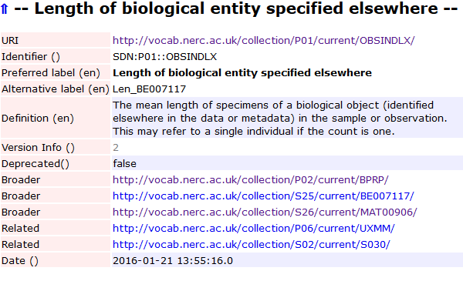
Data Standardisation
MeasurementType
MeasurementValue
MeasurementUnit
+ MeasurementTypeID
+ MeasurementValueID
+ MeasurementUnitID
Extended MoF Extension
Controlled vocabulary
Persistent identifiers (URIs)
MeasurementType MeasurementTypeID
length http://vocab.nerc.ac.uk/collection/P01/current/OBSINDLX
Length http://vocab.nerc.ac.uk/collection/P01/current/OBSINDLX
Length (mm) http://vocab.nerc.ac.uk/collection/P01/current/OBSINDLX
length_in_m http://vocab.nerc.ac.uk/collection/P01/current/OBSINDLX
Length of specimen http://vocab.nerc.ac.uk/collection/P01/current/OBSINDLX
…
Notes:
So in the lengths example I showed earlier, we would add a URI to the BODC vocabulary. Using the BODC webservices for this vocabulary OBIS can than get the preferred label for that term and also a definition.

Slide 9
Event Core – event hierarchy
Event 1
Station
eMoF A1
Event 1.1
eMoF A2
Sample
Event 1.1.1
SubSample
Occ 1
eMoF B1
eMoF B3
Occ 3
Occ 2
eMoF B2
Notes:
Explain: sampling campaign.
Station: coordanates + stationID
Sample: maybe just date, more precise coordinates?
Subsample: describe situation + grouping subsamples
So there is a way to built structure in events and actions using DwC. You can say: at this subsample is part of that sample. And you can link parameters to the level which is most appropriate.

Slide 10
Statistics
OBIS – env Bird tracking example dataset http://ipt.iobis.org/obis-env/resource?r=gulltracking
2 bird specimen
1 year of data
More than 100K position records
# detections in Belgium between 2013-06/09 = 32K position records

Slide 11
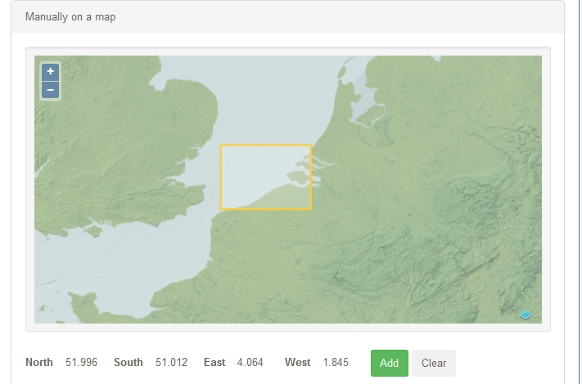
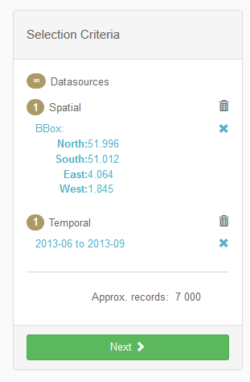
Statistics
Data in EMODnet - Biology
Belgium – Summer of 2013
Notes:
So when some requests data from a portal, you don’t what to offer them the 32.000 records of the 2 birds together with the 7000 sampling records.
But you still want to include record(s) to make clear that gulls are present at that time and location

Slide 12
Grouping of sorts is needed
HOW ?
WHO?
What detail?
Provider (ETN) or Aggregator (OBIS)?
Notes:
We still the downloaded data to say that (these) gulls appear in the summer 2013 in some level of detail. But what detail?
Who does it? If we use the same algorithm for all then the OBIS could do it. If it’s species or region or even dataset dependent then maybe the provider should.

Slide 13
Birds Tracking Data
A GPS tracker placed on a bird → a “sampling descriptor”
Generates a detection each x minutes
Abiotic sensor (linked to detections)
When captured the birds is measured → biotic measurements

Slide 14
OBIS env 2015/17 schema birds tracking
Capture/ release
Biotic measurements
Occurrence
detection
Tracking sensor type
Grouped detections
Tracked animal
detection
Abiotic
measurement
Track
Grouped detections
Recapture/ rerelease
Biotic measurements
Occurrence
Notes:
The idea here is to store all

Slide 15
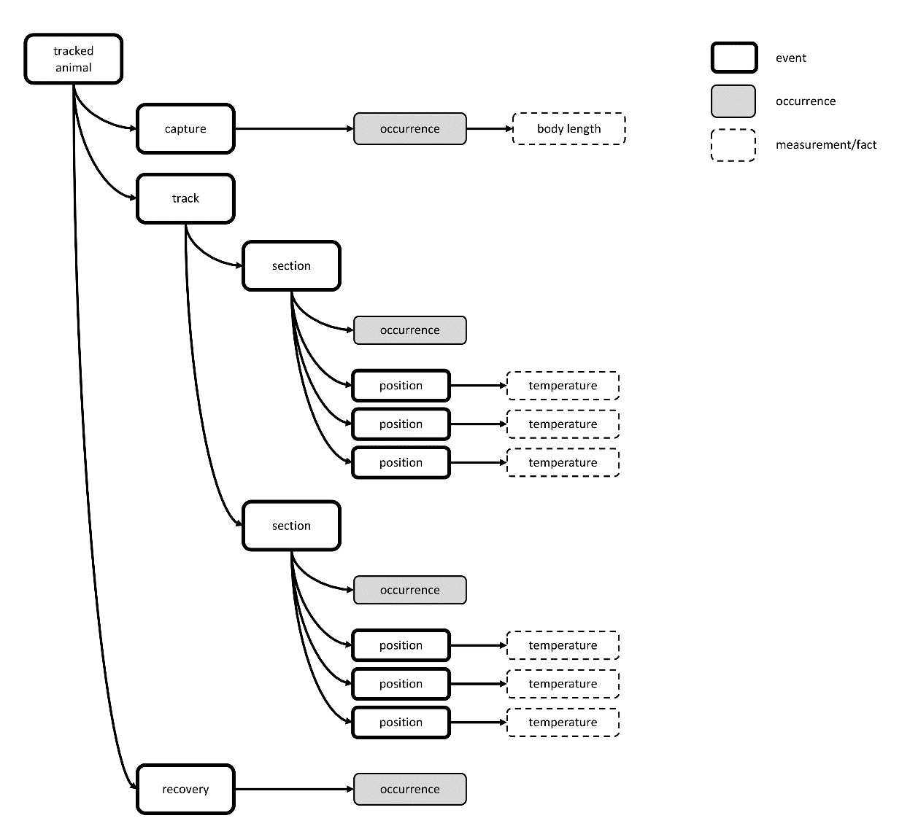
OBIS env 2015/17 schema birds --> provider decides
Grouping of sorts. e.g 1 record for all detections during 1 week
No occurrence records for the individual detections
Dataset: http://ipt.iobis.org/obis-env/resource?r=gulltracking
Schematic: https://tinyurl.com/OBIStelemetry

Slide 16
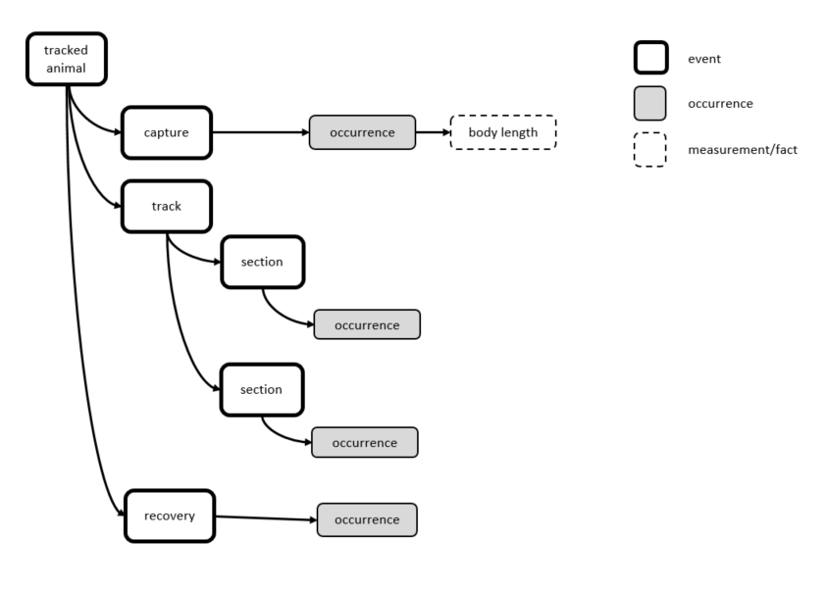
What would be downloaded as occurrences from OBIS?
Grouping of sorts
e.g 1 record for all detections during 1 week
100.000 detections reduced to 104 occurrence records
Notes:
The individual detections can be used in a viewer portal
But when people download occurrence data this is what they would get together with data from samples.
For the grouping, maybe a during summer when they are stationary, 1 record a month is fine? When they are migrating maybe 1 occurrence record a day is needed?

Slide 17
Can it be simplified?
Capture/ release
Biotic measurements
Occurrence
Grouped detections
Occurrence
Tracking sensor type
Bird specimen
Track
detection
Abiotic
measurement
Grouped detections
detection
Recapture/ rerelease
Biotic measurements
Occurrence
Notes:
You may not need the bird specimen event. Cause the organismID contains a global unique id for the bird.
Maybe the type of tracking instrument is not of instrest to people looking at OBIS data. That means you can remove the event track.

Slide 18
Birds tracking data – minimal complexity with built in grouping
Capture/ release
Biotic measurements
Occurrence
Grouped detections
Occurrence
detection
Abiotic
measurement
Grouped detections
detection
Recapture/ rerelease
Biotic measurements
Occurrence

Slide 19
Birds tracking data – minimal complexity OBIS download
Capture/ release
Biotic measurements
Occurrence
Grouped detections
Occurrence
Grouped detections
Occurrence
Recapture/ rerelease
Biotic measurements
Occurrence

Slide 20
Fish tagging data
Fish are captured tagged and released → biotic measurements
A network of receivers is installed a fixed positions
When the fish tag approaches a receiver
Detections
Can be grouped into residences
Residences per receiver vs residences per receiver cluster
Sensor measurements
Notes:
Residences = all detections as long as the animal stays close = 1 residence. Where the animal moves away for a certain time and then comes back then that’s a new residence.
The time where there are no detections can be set at different times.

Slide 21
OBIS env 2015/17 applied to tagging data
Capture/ release
Biotic measurements
Occurrence
Occurrence
tagg type
residences
detection
Tragged animal
Abiotic
measurement
detection
residences
Recapture/ rerelease
Biotic measurements
Occurrence
Notes:
Residences.

Slide 22
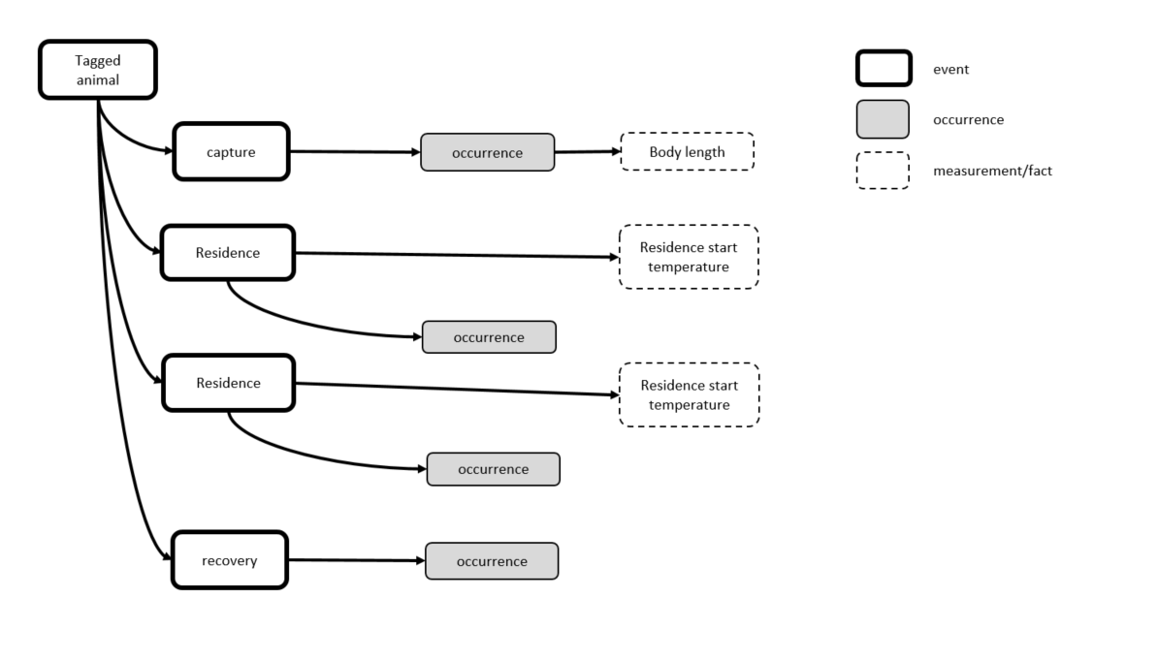
OBIS env 2015/17 applied to tagging data

Slide 23
OBIS env 2015/17 applied to tagging data
Capture/ release
Biotic measurements
Occurrence
Occurrence
Receiver type
residence
Tragged animal
FIRST Abiotic
measurement
residence
Recapture/ rerelease
Biotic measurements
Occurrence
Notes:
Residences.

Slide 24
OBIS env 2015/17 applied to tagging data
Capture/ release
Biotic measurements
Occurrence
residence
Occurrence
FIRST Abiotic
measurement
residence
Occurrence
FIRST Abiotic
measurement
Recapture/ rerelease
Biotic measurements
Occurrence

Slide 25
ETN fish tag demo dataset (cods + eels)
4 years data
190 tagged fish
134 receivers
2.6M detections
Average ([latest detectionDate] – [earliest detectionDate]) = 4.1 months
Notes:
It’s a trade of between having enough detail to be able to produce a tracking product and not to much detail as to not to polute the download.
Or you introduce a grouping level on top of the residences.

Slide 26
ETN fish tag demo dataset (cods + eels) -> residences
What occurs in Belgium Summer 2015?
17 eel specimen at 16 stations → average 1.7 stations visited per specimen
16 cod specimen at 8 stations → average 2.7 stations visited per specimen
# Residences per receiver with 1 hour cut off (total = 150k records)
6.6 residences per specimen per day
5.5K records for eel
13K record for cod
# Residences per receiver with 24 hour cut off (total = 17k records)
0.7 residences per specimen per day
604 records for eel
1,121 records for cod

Slide 27
Linking from OBIS to ETN
OrganismID could be a URI linking to the detailed track of the organism at ETN
LocationID?
Notes:
LocationID is difficult as the receivers get moved around from one station to another and there is no real StationID in the database.

Slide 28
Idea’s for grouping idea’s by aggregator (OBIS)
Belgium – Summer of 2013

Slide 29
Idea’s for grouping idea’s by aggregator (OBIS)
Download portal only contains the capture (or recapture) records with a link to the track
Download portal provides a single record for each specimen with link to the track. Portal search function considers the entire track to determine whether to include.
Download portal provides information about presence of the species without focus on the specimen itself
e.g. the portal says X tracked specimens of species Y occurred in this grid for this time period
Resulting gridded record could even pool specimens from different datasets together?
Notes:
This last one seems most useful for people looking for occurrence data. Here OBIS generates gridded distributions of how many tagged individuals occur in a certain area at a certain period. What then is left is decide how large a grid and how much time.
Downside is that this does not allow for (easy) linking to the individual tracks.

Slide 30
Discussion points
What kind of detail does OBIS need to produce data products?
Define how data should be downloaded from OBIS portal.
Should this be defined by the provider (ETN) or by the aggregator (OBIS)?

Slide 31
Aggregation defined by provider
Needs to be integrated into the format
need event hierarchy
Possible to tailor-make aggregates for your dataset
(regional differences, species differences,…)
Different providers may have different views for solving the same problem
Not all datasets will do this (correctly – complex,… )
Maybe not all aggregators would promote this

Slide 32
Groupings defined by aggregator
Different aggregators may have different solutions
Likely to be a one fits all solution (all taxa and regions treated the same?)
The aggregator may need a way to distinguish tracking from tagging datasets?

Slide 33
CPODs
Acoustic listening
Deployment of a receiver
Detects the sound of dolphins when they are singing
Impossible to identify individuals based on songs

Slide 34
CPODs proposal
# of hours during which the species was detected that day
Occurrence harbor porpoise
Day 1
Occurrence common dolphin
Total singing duration
CPOD Deployment
Day 2
No detections
Day 3
Occurrence harbor porpoise
It’s a CPOD!
Type of CPOD?
Notes:
CPOD Deployment = coordinates + start and stop deployment
Day 1 = all detection that day in a single occurrence record = an event record without any coordinates. Just to specify the day. 2 species detected → 2 occurrence records
Day 3 = only harbor porpoises recorded
Day 2 = no species recorded → no record included? Or do you include a record saying no harbor porpoise detected?

Slide 35
CPODs Absence records…
Sometimes a recording but no certain identification (to high noice ratio) → “maybes”
We are able to detect (most?) dolphin species. So we know that most of the time e.g. no common dolphin was close, cause otherwise it have been detected.
→ Create absence records for all taxa which we would be able to distinguish? Or only of those which may occur here?
Methodology explains which species would have been detected? (listening frequencies?)
Add a taxonomic scope of what could be detected? (Dolphins with songs between X-Y frequencies, and OBIS can generate a species list from WoRMS)
Add species list of what could have been detected?
Notes:
Add species list means that each provider will need to do a literature study seeing which are the song frequencies of all dolphins.
Unless you just look at the dolphins you expect.

Slide 36
Linking from OBIS to ETN
The eventID of the deployment could be a URI linking to the detailed ETN data

